Slide 1


MSC Industrial (MSM) Financial Analysis

Slide 2
Company Overview
MSC Industrial (MSM) is a leading North American distributor of industrial and metalworking supplies, offering products and services to support manufacturers, contractors, and other industries. The company provides a wide range of products, including cutting tools, abrasives, machinery, safety supplies, and more, catering to various industrial needs.
MSM operates a highly customer-centric distribution model that combines traditional catalog-based selling with modern e-commerce and digital solutions. The company's multichannel strategy leverages a nationwide network of distribution centers, local branch offices, and a robust online platform to ensure fast and reliable delivery.
Core Product Categories
Metalworking
Safety & PPE
Maintenance, Repair, and Operations
Material Handling & Storage
Machinery & Equipment
Competitive Strengths
Extensive Product Selection
Strong Distribution Network
Customer Relationships
Established Brand Reputation
Technological Advancements

Slide 3
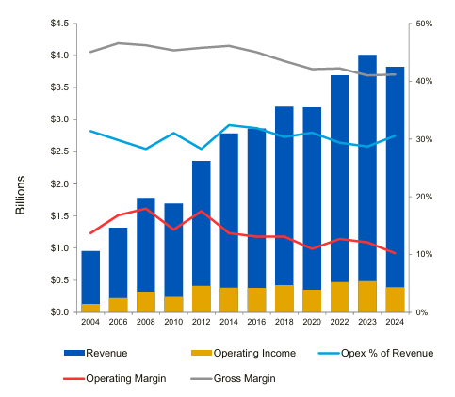
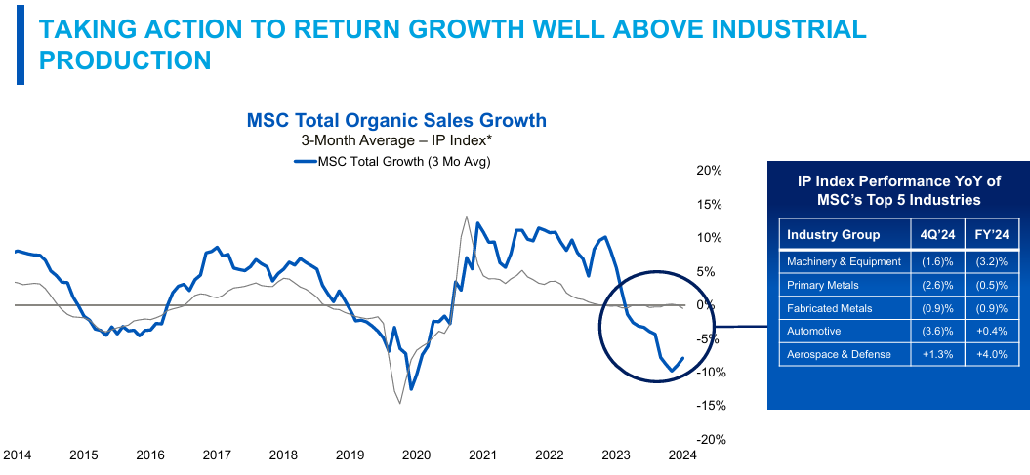
Performance Update
Revenue: Over the past decade, MSM has demonstrated consistent revenue growth, with recent annual revenues crossing $4 billion and a contraction of (-4.7%) forecasted and realized in Q4’24.
FY25 expected to be slightly negative, with a growth rate of (-0.5%), before returning positive & growing for the remainder of the forecast period.
Gross Margins: Recent margins have remained stable (~41%), supported by efficient procurement and value-added services, but face pressure from inflationary costs in raw materials & logistics.
Operating Margins: Continuous investments in digital transformation and logistics optimization have helped maintain competitive operating margins despite rising costs.

Slide 4
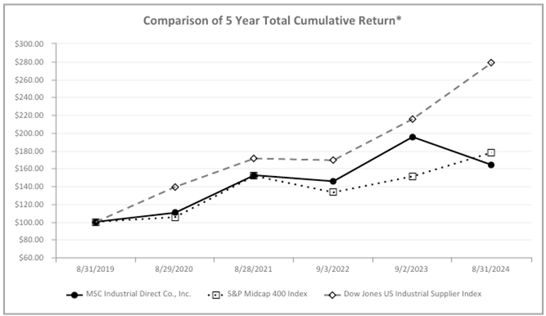
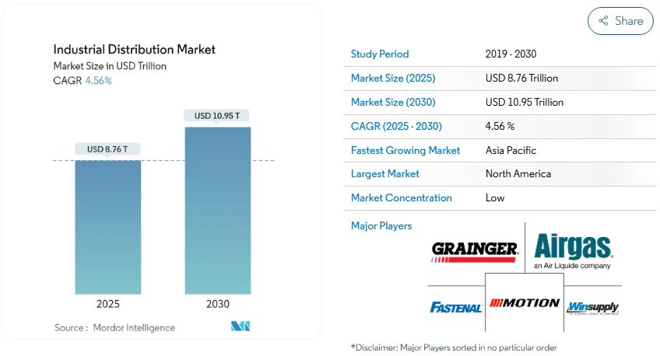
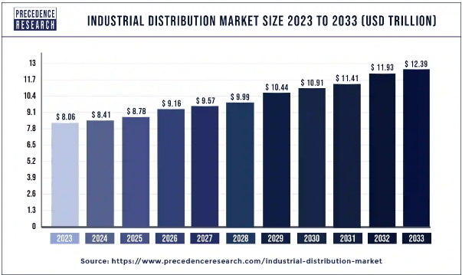
Industry Overview & Outlook
Largely fragmented market
Steady growth projected, fueled by reshoring, infrastructure investment, and automation. Digital transformation remains a major growth driver, and companies offering integrated, value-added solutions will be better positioned for success.
Inflationary pressures, supply chain disruptions, heightened competition, and labor shortages all present challenges to the industry.

Slide 5
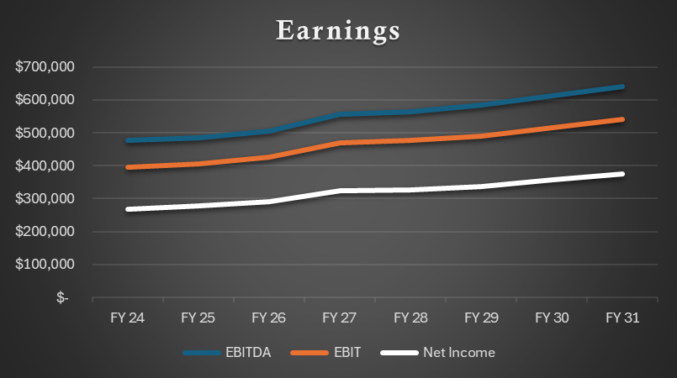
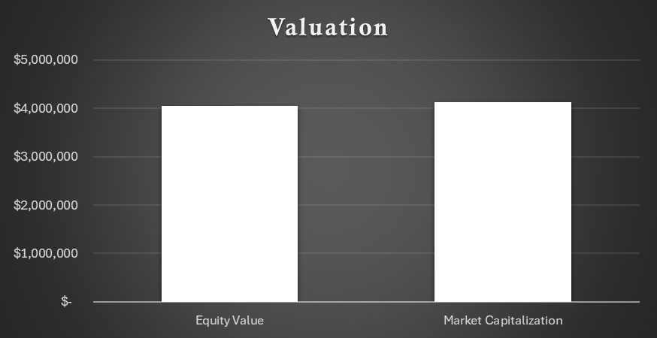
Base Summary Outputs ($73.12 Share Price)

Slide 6
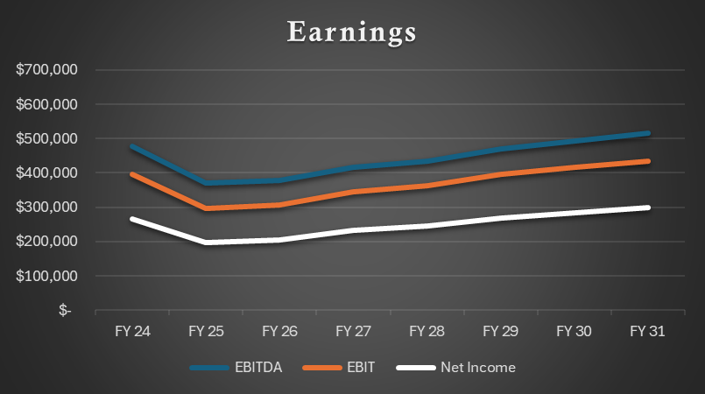
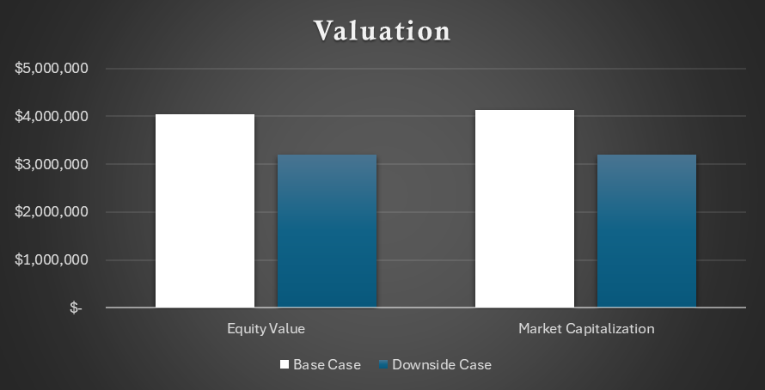
Downside Summary Outputs ($57.27 Share Price)

Slide 7
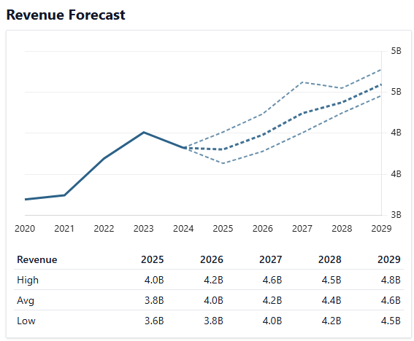
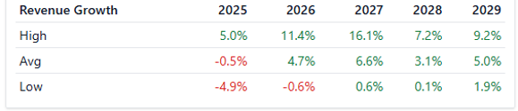
Base Rationale
Revenue
Contraction in FY24 (-4.7%) is followed by slightly negative growth in FY25 (-0.5%).
Revenue recovers in FY26 (+4.7%) and continues to grow over the forecast period.
MSC Industrial Direct Co., Inc. (MSM) Stock Forecast & Price Targets - Stock Analysis
OpEx
Decline as a percentage of revenue (from 30.4% to 29.8% by FY31) through tight cost controls and scaling efficiencies
Margins
Stable Gross Margin of ~41%
CapEx
Controlled at ~2% of revenue, prioritizing essential and high-ROI projects
Income Tax
Effective tax rate remains steady at ~24.5%
Working Capital
Improved efficiency supports liquidity, with NWC gradually increasing in line with growth
EV Assumptions
FCF Method = OCF - CapEx, consistent with MSM’s SEC filings & methodology
g = 3.0%
Shares Outstanding = 55,900
MSC Industrial Direct Co., Inc. (MSM) Statistics & Valuation Metrics - Stock Analysis
3-Year Average PE Ratio = 15.47
MSM - Msc Industrial Direct PE ratio, current and historical analysis

Slide 8
Downside Rationale
Revenue
Global recession inhibits MSM’s ability to recover from FY24’s contraction.
Revenue growth remains negative through FY26 and slowly stabilizes as the recession diminishes and demand returns.
OpEx
Fixed costs remain elevated even as revenue decreases.
Recessions can coincide with inflationary periods, where costs rise even as demand softens.
Additional marketing & sales costs may be expected as companies seek to regain market share as their customers reduce spending.
Margins
Input cost inflation, lower volume discounts, inventory holding costs, and production inefficiencies deteriorate margin.
CapEx
Capital expenditure decreases as companies seek to reduce spending.
Income Tax
In general, income tax does not materially change during a recession.
Working Capital
Declining sales & fluctuations in demand may lead to excess inventory.
Customers may delay payments to preserve liquidity, increasing AR.
Suppliers may tighten payment terms due to increased credit risk, decreasing AP.

Slide 9

Investment Recommendation
The Good
Diversified customer base, strong supply chain, & consistent demand
Consistent returns for shareholders & share buybacks
Stable gross margins, reliable FCF, manageable debt levels, & cost saving initiatives
Investments in e-commerce enable MSM to capitalize on new growth opportunities
Positioned to benefit from US reshoring trends and infrastructure investments
The Bad
Revenue and profitability highly exposed to industrial cycles
Consistent underperformance against Dow Jones US Industrial Supplier Index
Heavy insider selling over the past 12 months
The Decision
Investment in MSM could be a reasonable decision in the context of a broader strategic initiative or a desire to recognize higher dividends in the industrial distribution sector.
Given consistent underperformance against the index and heavy insider selling, it may be worth evaluating alternatives.
MSM reported FY24 earnings on October 24th, 2024. Its adjusted share price closed at $77.04.
Considering an implied share price of $73.12, this would suggest MSM is overvalued. This assessment is heavily contingent on market conditions and PE assumptions.
The PE ratio selected for modeling purposes is lower than the 10-year historical average of 17.55, indicating that the implied share price may be higher.

